Slide 1

Quarterly GDP Nowcasting for Rwanda
Young Economics Program (YEP)
MPD-OCE, Minecofin.
April 2026

Slide 2
Outline & Content
Introduction
Rationale & use
Variables and data
Methodology
Key steps
Nowcasting in practice—Eviews program
Illustrated results
References

Slide 3
Introduction
Monetary and fiscal policies depend on evaluations of current and short-term economic conditions
Data issues in terms of irregularity and timeliness of published data.
Nowcasting (forecast current—now) approach estimates current (now) Qo GDP using HFIs available data
Bridge Equations (BEs) are small-scale models used to "bridge" the information contained in individual HFIs using single equations, with the Qo growth rate of GDP
multiple linear equations (MLEs) associating two or three indicators, which make sense from an economic or statistical point of view and fit well the data
BEs, MLEs and combination outperform other models incl. MIDAS, VAR, ARMA, DFM …..)

Slide 4
Rationale & use
NISR Qo GDP publication lags for a quarter (3 Mos)
Evaluation of short-term macroeconomic conditions
Forecasting (nowcasting) of current Qo and next Qo (i.e., Q1 & Q2 2024)
Inputs/ assumptions to macroeconomic projections:
Integrated Macro-Framework (MF) projections
Quarterly Macro Fiscal Model (QMFM)
In-year assumptions for actual tax ratios and other estimations.

Slide 5
Application of nowcasting –economic policy
A tool for monitoring and surveillance of macroeconomic policy
A watchtower of the direction GDP growth performance in short-run
Economic developments and diagnosis:
High frequency indicators (i.e., turnovers and composite index of economic activities—CIEA)
Other imports, trade and production indicators
Key analytical thoughts is to link the forecasts drivers with other economic indicators
Is growth in turnovers (sales) or imports consistent with level of tax declarations?

Slide 6
Variables & data sources
Indicator | Frequency | Delay | Source Institution | Starting date
CPI Headline, Urban | Monthly | 10 days | NISR | Jan 04
PPI | Published quarterly, data monthly | 4-6 weeks | NISR | Jan 05
broad money, credit to private sector | Monthly | 25 days | BNR | Jan 03
VAT receipts | Monthly | 20 days | RRA | Jan 06
Exchange rate (current prices, USD) | Monthly | 1 day | BNR | Jan 06
Imports/Exports of goods (volume, value) | Monthly | 20 days | BNR | 1998
Industrial production (beer, soft drinks, rice, cement, flour, milk, electricity, and water) | Published quarterly, data Monthly | Up to 2 months | NISR/BNR | Jan 2006
BNR’s Composite Indicator of Economic Activity (Real) | Monthly | 25 days | BNR | Jan 2012
Turnovers (Industry, construction, services, hotel, financial serv., Trade, transport) | Monthly | 1 month | NISR | Jan 2012
IIP (Index of Industrial Production) | Monthly | 1 month | NISR | Jan 2011

Slide 7
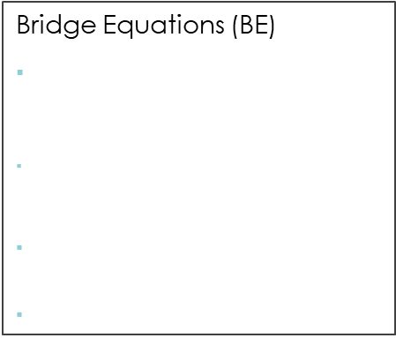
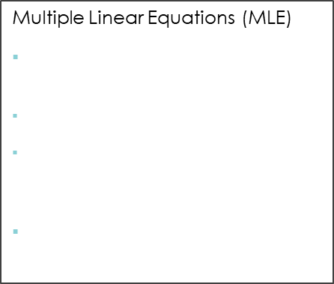
Methodology
1. ARIMA forecast
2. Data frequency conversions/aggregation
3. Estimation of equation
Automatic ARIMA extension of lagging indicators based on specifications:
Starting points (selection of peaks in series)
Max & Min lags
Forecast length (e.g. Lags or missing obs.)
ARIMA(1,0,0) = first-order autoregressive model with a constant
High to lower frequency
GDP is observed on Qo basis
Conversion from monthly to quarterly frequency for all HFIs using:
Average function for rates or stock indicators (e.g. CPI, ER, CIEA, IIP and PPI.
Sum function for other nominal or level or flow indicators (e.g., exports vol & val, cement, milk and drinks prod and turnovers)
Bridge Equations (BE)
Bridge equation (BE) uses a HFI as regressor in a single equations with GDP
$\operatorname{dlog}\left(GDP\right)= α+ β_{1}{dlog⁡(GDP)}_{t−1}+… β_{4}d{log⁡(GDP)}_{t−i}+ γ_{1}d{log⁡(HFI)}_{t}+γ_{2}{dlog⁡(HFI)}_{t−1}+…γ_{5}{dlog⁡(HFI)}_{t−j}+ε$
ARDL models (better fit than OLS)
Sample : 2006-2025
Multiple Linear Equations (MLE)
3 Eqs represent supply, demand and, monetary sector
$\operatorname{dlog}\left(GDP\right)=β_{0}+β_{i}\log\left({HFI}_{i}\right)+ ε$
${HFI}_{i} r$epresents cpi, turnovers, money supply, CPS and electricity production
OLS Estimation is used
4. Forecast (static) of BEs & MLEs
5. Forecast evaluation & averaging
6. Seasonal adjustment (sa)
Forecast for BEs and MLEs to obtain next Qo using specifications:
Series at levels (no transformation like diff or dlog)
Static forecast as forecast method
Forecast sample (i.e., 2026Q1 2026Q3)
Out-of-sample (actuals included in forecast sample( i.e., 2017Q1-2024Q2)
Forecast evaluation for FE statistics & graph as output
Independent evaluation of BEs and MLEs forecasts for each equation using:
FE methods (simple mean, MSE, MSE ranks,, simple median and least squares)
FE statistics for forecast accuracy/uncertainty (RMSE, MAE, MAPE, SMAPE, Theil’s U Statistics) to select ones with least forecast errors.
Independent FA of 10 Bes & 3 MLEs and combine the outcome (2 series to 1 (BE &MLE) using corr. least FE statistics
Final GDP s.a—combination/average of BE& MLE
Final Real GDP (FA of BE & MLE)
Not seasonal adjusted (Ann yoy % change)
Seasonally adjusted using EVIEWS built in function (X12)
Not adjusted and SA don’t deviate much
FA of (individual) sa indicators gives minor deviations
Notes:
Common Statistical Measures for Forecast Uncertainty/accuracy 1. Bias: the difference between the forecasts and the correct outcome, 2. Variance (“standard forecast error,
SE”) sqrt of (FE-BIAS), 3. MSE—combination of SE & BIAS, 4. RMSE sqrt of MSE, 5. MAE and MAPE 6. Theil’s U Statistics for forecast accuracy (U1) and quality (U2)—compares forecast with benchmark or naïve forecasting model. Forecast evaluation statistics worsen as forecast horizon increases.

Slide 8
Key steps for nowcasting
Update available monthly data (i.e., turnovers, production and exports) from different sources
Autoregressive Integrated Moving Average—ARIMA: fill/fit the data-sample forecast for missing (identify best starting points);
Data aggregation (transformation from monthly to quarterly using summation & average functions);
Bridge and Multiple Linear equations estimations (ARDL and OLS);
Static in-sample forecasting for all BEs & MLEs equations
Forecast errors evaluation: using forecast evaluation methods and evaluation statistics incl. RMSE, MAE, MAPE, SMAPE, Theil Inequality Coefficients U1 and U2);
Selection of best BEs and MLEs forecasts (i.e., 10 BE & 2 MLE forecasts);
Forecast averaging/combination (using least errors forecast evaluation method) –average 10 BEs into 1 & 2 or 3 MLEs;
Forecast evaluation and average for 1 BE & 1 MLE for final combined GDP (Real GDP final);
Seasonal adjustment for final GDP
Pre-tests methods
Stationarity and stability tests
Structural breaks (Dummy variables)
ARIMA (best starting sample points, maxar, maxma)
Autocorrelation (Partial Autocorrelation Function (PACF)
Model selections (Why BE & MLE not DFM or ML)
ARIMA is a method to fit time series data: there more methods i.e., Box-Jenkins Method
Notes:
-Autoregression model means we forecast the variable of interest using a linear combination of past values of the variable. The term auto-regression indicates that it is a regression of the variable against itself. This technique is similar to a linear regression model in how it uses past values as inputs to the regression. $y_{t}=C+φ_{1}y_{t−1}+φ_{2}y_{t−2}+...φ_{q}y_{t−q}+ε_{t}$
-A moving average model on the other hand uses the past forecast errors rather than using past values of the forecast variable in a regression. A moving average simply averages k values in a window, where k is the size of the moving average window, and then advances the window. The forecast values are evaluated using the actual values to determine the error at each step in the time series. $y_{t}=C+ε_{t}+θ_{1}ε_{t−1}+θ_{2}ε_{t−2}+...θ_{q}ε_{t−q}$

Slide 9
Other (neo)classical methods
Machine Learning Algorithms (Nowcasting New Zealand GDP using machine learning algorithms. IFC Bulletins chapters in Bank for International Settlements)
Dynamic Factor Models-DFM (Dynamic factor model (DFM)-Bańbura, M., and Modugno, M. (2014). Maximum likelihood estimation of factor models on datasets with arbitrary pattern of missing data)
Mixed Data-frequency Sampling-MIDAS (Nowcasting Philippine Economic Growth using MIDAS Regression Model and Nowcasting Rwanda’s Quarterly GDP Using Mixed-Frequency Methods)

Slide 10
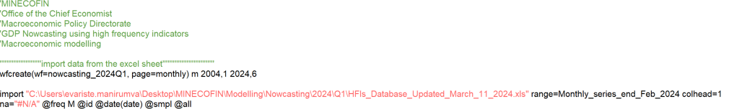
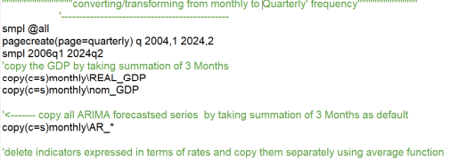
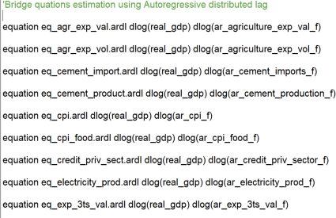
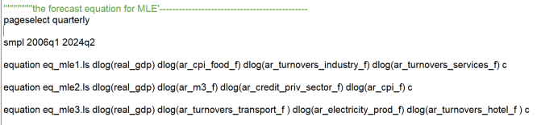
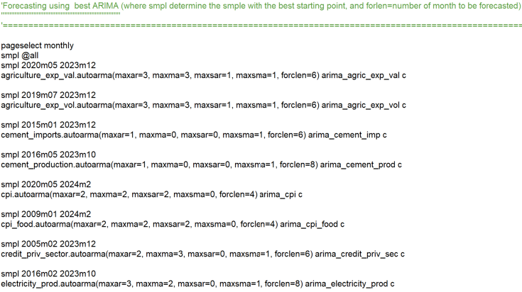
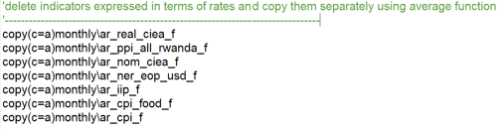
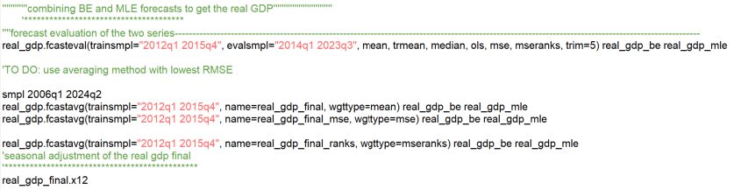
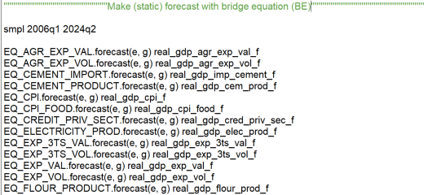
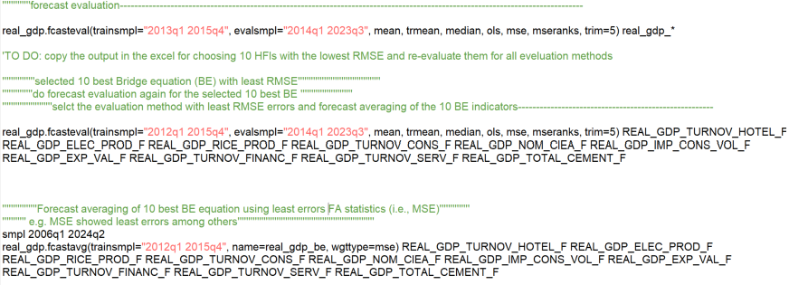
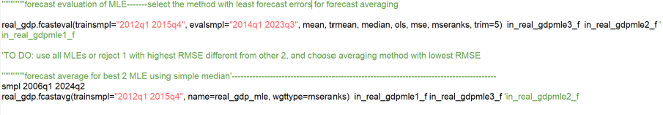
Nowcasting in practice—highlights from EVIEWS program
1. ARIMA forecast/projections
2. Data frequency conversions
3. Estimation of equations
6. Final GDP forecast average
4. Forecast (static) of BEs & MLEs
5. Forecast evaluation (FE) & averaging
Notes:
Common Statistical Measures for Forecast Uncertainty/accuracy 1. Bias: the difference between the forecasts and the correct outcome, 2. Variance (“standard forecast error,
SE”) sqrt of (FE-BIAS), 3. MSE—combination of SE &BIAS, 4. RMSE sqrt of MSE, 5. MAE and MAPE 6. Theil’s U Statistics for forecast accuracy (U1) and quality (U2)—compares forecast with benchmark or naïve forecasting model. Forecast evaluation statistics worsen as if forecast horizon increases.

Slide 11
Demonstration—Methodology
A live demonstration of the run/navigation of EVIEWS program here
Notes:
Common Statistical Measures for Forecast Uncertainty/accuracy 1. Bias: the difference between the forecasts and the correct outcome, 2. Variance (“standard forecast error,
SE”) sqrt of (FE-BIAS), 3. MSE—combination of SE &BIAS, 4. RMSE sqrt of MSE, 5. MAE and MAPE 6. Theil’s U Statistics for forecast accuracy (U1) and quality (U2)—compares forecast with benchmark or naïve forecasting model. Forecast evaluation statistics worsen as if forecast horizon increases.

Slide 12
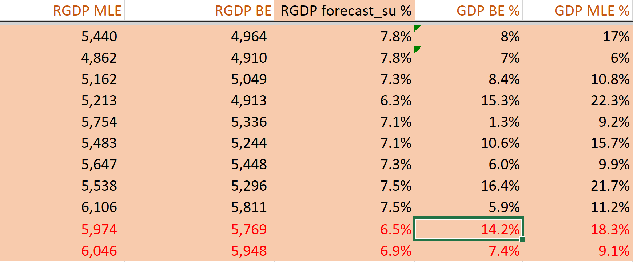
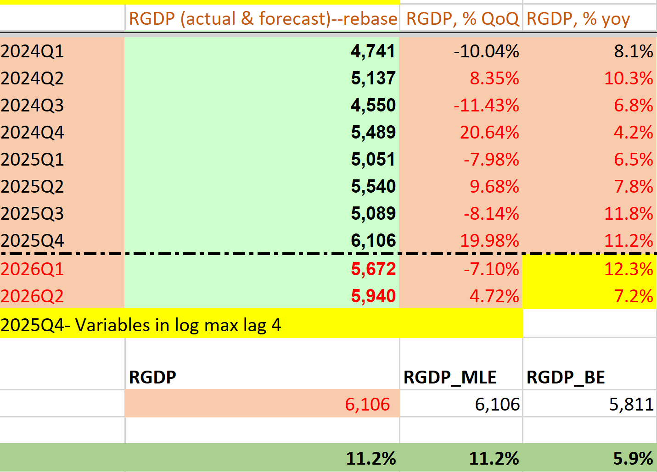
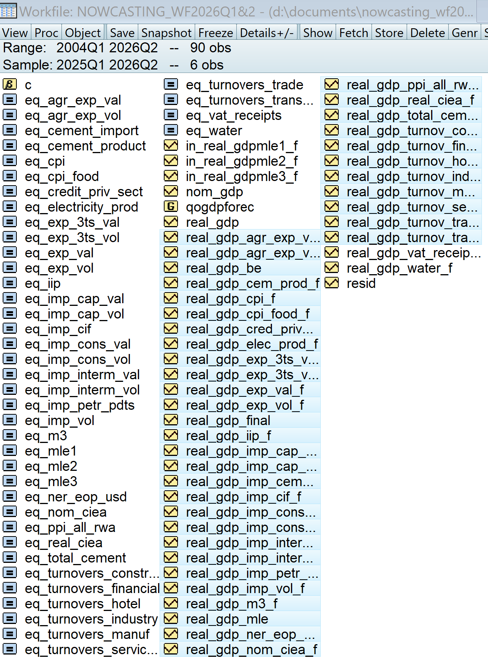
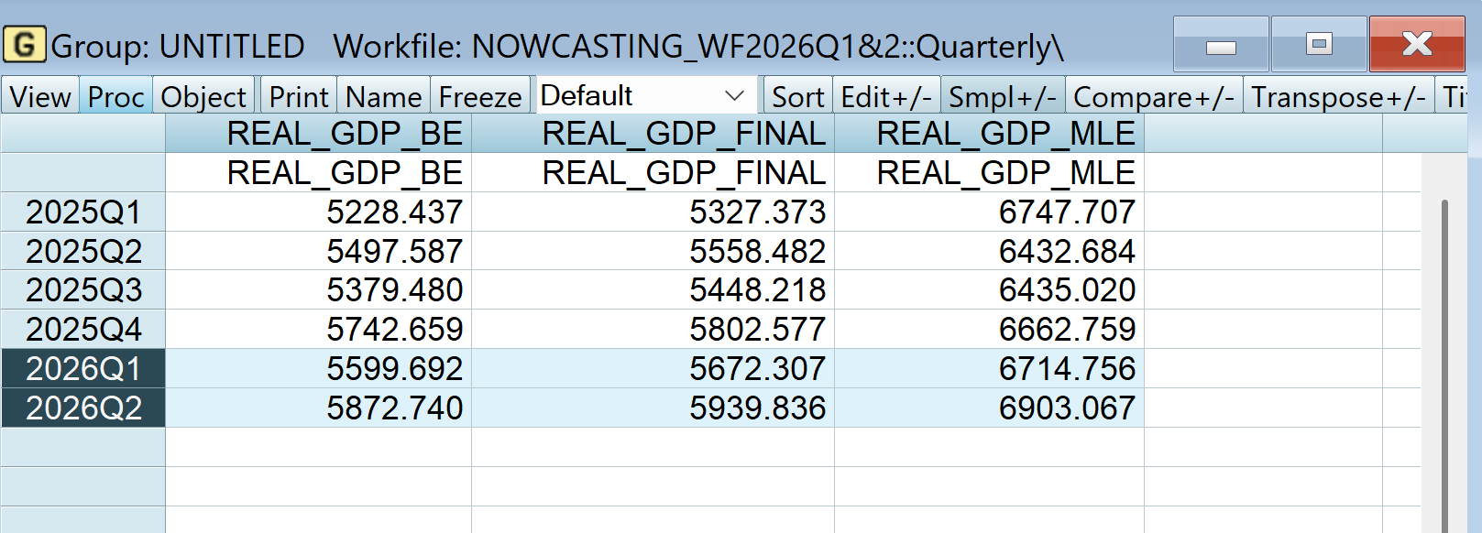
Illustration—results & reporting
Notes:
Common Statistical Measures for Forecast Uncertainty/accuracy 1. Bias: the difference between the forecasts and the correct outcome, 2. Variance (“standard forecast error,
SE”) sqrt of (FE-BIAS), 3. MSE—combination of SE &BIAS, 4. RMSE sqrt of MSE, 5. MAE and MAPE 6. Theil’s U Statistics for forecast accuracy (U1) and quality (U2)—compares forecast with benchmark or naïve forecasting model. Forecast evaluation statistics worsen as if forecast horizon increases.

Slide 13
Results presentation/illustration
Best GDP indicators (minor error—MSE)

Slide 14
References
Kalisa, T. & Nsanza, J.U. (2018). Nowcasting GDP in Rwanda. BNR Economic Review, 12.”.
“Angelini, Elena, et al. (2011) "Short‐term forecasts of euro area GDP growth." The Econometrics Journal 14.1: C25-C44.”
Habimana, O. et al., (2020) Nowcasting Rwanda’s quarterly GDP using mixed-frequency methods. https://ssrn.com/abstract=3653136
Christian M. et al., (2022) Nowcasting the Real GDP Growth of Rwanda. BNR Economic Review 19 (2022) 39–54
New Econometrics and Statistics: Forecasting: https://www.eviews.com/EViews9/ev9ecforc_n.html

Slide 15
Group activity
Materials-resources and instructions:
EVIEWS program (all codes and methods)
HFIs database
Results framework
EVIEWS forecasting documentation (https://www.eviews.com/EViews9/ev9ecforc_n.html )
Relevant references
A brief template (cover, background, forecast results, drivers and recommendation)
Form random groups of 5 persons (8 groups)
A working EVIEWS is a priority
To-do:
Forecast GDP for 2026 Q1, 2, 3
Present the drivers for Q1 & 2 forecats
Make a short brief of the results
Provide your recommendation and any analytical thoughts
To be submitted by Sun 26, April 2026 @12PM

Slide 16

Murakoze!!!

